Slide 1
SOME GLIMPSE OF OUR WEBSITE

Slide 2
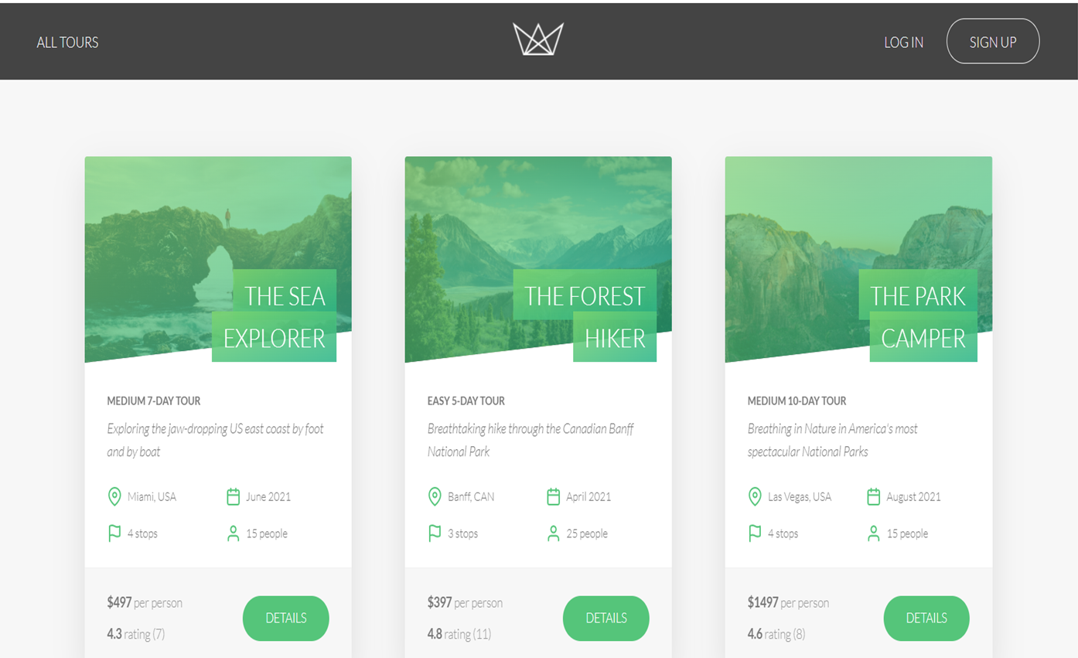

Slide 3
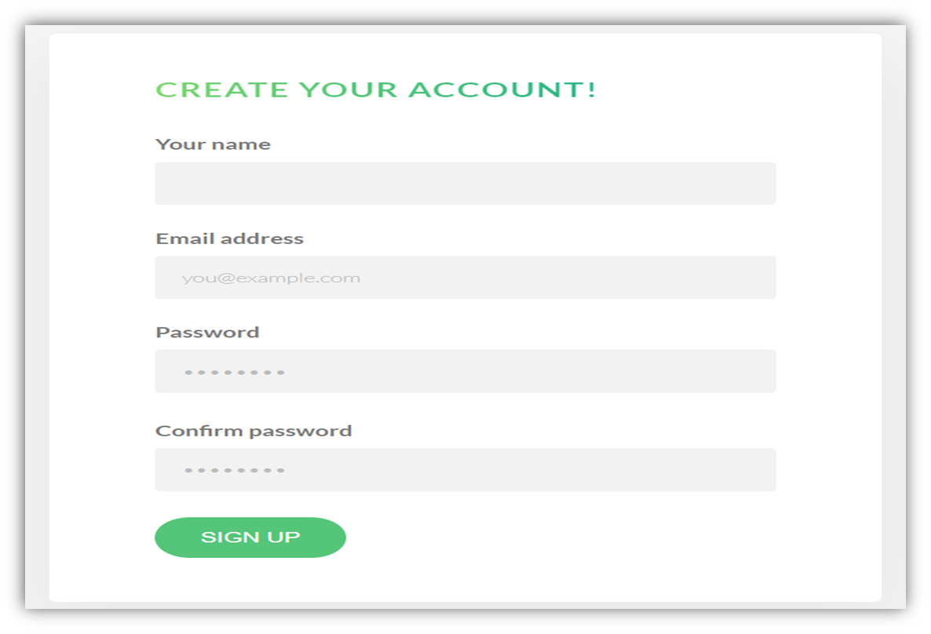
LOGIN OR SIGNUP PAGE

Slide 4
TECHNOLOGIES USED

Slide 5
Website
CEO
Frontend
Backend
Ronny Reader
Abby Author
HTML
CSS
Javascript
Node Js Express JS
Mongo DB
Mongoose
Perry Presenter
Vinny Viewer
Molly Maker

Slide 6
Features

Slide 7
List of features
Login/signup
Managing passwords
Password reset
Calculating average rating on tours
Image Uploads
Sending reset email
Credit card payments

Slide 8
Learning Outcomes

Slide 9
We got to learn the below mentioned things and many more
All about node.js
Building API
Node.js event loop
Asynchronous javascript
Express
API and restful API design
Handling post request
MongoDB
Creating hosted database
Using MongoDb with Mongoose
Error handling with express
Authentication, Authorization and Security of a website
Server side rendering
Git and GitHub

Slide 10
Thank You❤️

